Slide 1

Specializing Large Language Models using Chain of Thought Reasoning
Team-6:
Anvesh Kumar Chavidi
Eshita Gupta
Neha Thakur
Sandeep Reddy Potula
Saumya Varshney

Slide 2
PROJECT INTRODUCTION

Slide 3
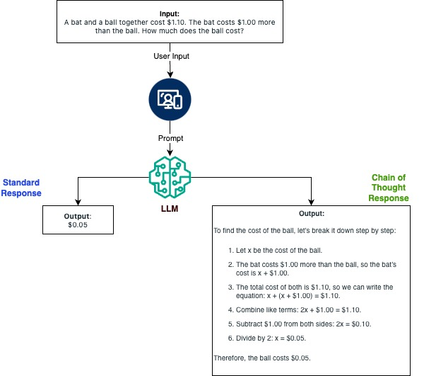
Project Motivation & Background
Challenges: Existing LLM(s) struggle with complex tasks like mathematical, common sense, and logical reasoning.
Motivation: LLMs are traditionally black boxes and its difficult to interpret how they are responding. Fine tuning the LLM with CoT techniques helps to make their decision making more interpretable. This enhances trust in the output in scenarios where transparency is key.
Chain of Thought (CoT) Reasoning: Mimics human way of problem-solving, enhances interpretability, and reduces errors.
Enhancing LLMs: Consolidating CoT techniques with combinations of Self-Consistency Training (SCT), Chain of Draft, GRPO, DPO and Tree of thought to improve efficiency and accuracy.
Intelligent Reasoning System: User-friendly interface that provides clear, step-by-step reasoning in responses for education domain, fostering trust and reliability.

Slide 4
Project Objectives and Needs
Development of an Intelligent Reasoning System with an Intuitive UI that provides with step-by-step explanations for problems and is capable of logical reasoning.
Capabilities: NLP, problem-solving, reasoning, explainable answers, and continuous learning
Data Pipeline: Apache Airflow, AWS, Hugging face Model hub, Gradio Interface
Datasets: Pre-annotated data for Mathematics, Logical Reasoning.
Training Techniques: CoT techniques with combinations of Self-Consistency Training (SCT), Chain of Draft, GRPO, DPO and Tree of thought
Evaluation Metrics: BLEU score, ROGUE score, Chrf, Correctness, GEval correctness, GEval logical coherence (LLM as a Judge)
Benchmarks: MATH, GSM8K, SVAMP

Slide 5
LITERATURE AND TECHNOLOGY SURVEY

Slide 6
Survey
Chain-of-Thought (CoT) Prompting:
Self-Consistency (Wang et al., 2023): Diverse reasoning paths for GSM8K, SVAMP with accuracy gains of up to 17.9%.
Symbolic CoT (Xu et al., 2023): Combines natural language and symbolic logic for tasks requiring first-order logic (FOL).
GAN-Augmented CoT (Park et al., 2024): Synthesizes CoT rationales for arithmetic reasoning (e.g., DROP).
RAFT (Zhao et al., 2024): Enhanced reasoning with Chain-of-Thought (CoT) prompting for multi-hop reasoning tasks (e.g., HotpotQA).
RAT (Wang et al., 2024): Combines RAG and CoT to improve long-horizon generation in GPT-3.5 and GPT-4.
Efficiency and Adaptation:
LoRA (Hu et al., 2021): Reduced parameter fine-tuning for large models (e.g., GPT-3).
Knowledge Distillation (Zhao et al., 2023): Smaller models replicate large-model reasoning.
Innovative Techniques:
Dynamic Memory Modules (Wang et al., 2024): Temporal reasoning in TimeQA.
Multimodal CoT (Tan et al., 2024): Integrates vision and text for VQA tasks.

Slide 7
DATA ENGINEERING

Slide 8
Data Collection
Collected from Reputable Platforms ​
OpenBookQA: AllenAI, hosted on HuggingFace ( Pre-splitted dataset)​
GSM8K: OpenAI, hosted on HuggingFace ( Train and Test split)​
MATH: UC Berkeley, hosted on UC Berkeley Servers ( Train and Test split)​
AIME: AoPS, hosted on AoPS Online Wiki (Scraped - No pre-split)​
Data Collection Process​
Wrote Python scripts to download, scrape, and standardize dataset formats for consistency.

Slide 9
Data Preparation
Dataset Requirements​ -
Must contain question-answer pairs in natural language (preferably English).​
Answers should be detailed and provide step-by-step solutions.​
Data Sources​ - Hugging face , Educational institutions, LLM leaderboards, Educational wikis
Preparing Train, Test, and Validation Splits
Pre-split Datasets: Already has Train, Validation and test splits.
Custom Splits: For datasets with only train and test, split train set into 80% training and 20% validation.
No Splits: Created 80-10-10 split (train, validation, test) for consistency across experiments.
Pipeline Overview
All raw datasets are merged in an AWS S3 staging bucket.
AWS Glue job handles data transformation and splits.
Processed training, validation, and test splits are deposited into respective S3 buckets.

Slide 10
Data Preprocessing and Transformation
Handling Missing Values -
Checked for missing values in all the datasets GSM8K, OpenBookQA, and MATH. There were no missing values.
Minimal missing values in AIME due to structed competition format.
Duplicate Removal -
Checked for duplicates in GSM8K, OpenBookQA, and MATH to maintain unique entries.
AIME dataset already had minimal redundancy due to unique competition-year structure.
Field Restructuring -
Organized multiple-choice questions and answers for consistent processing.
Parsed JSON files to extract problem, solution, and type fields
Converted markdown files to structured fields (year, test_type, problem, solution), ensuring stepwise reasoning.
Cleaned/Staging Data​
dataset_id​
question_id​
question_text​
answer​
reasoning​

Slide 11
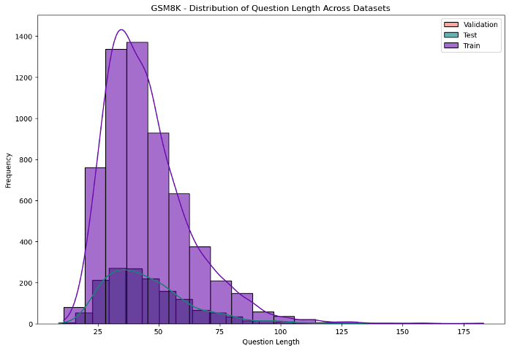
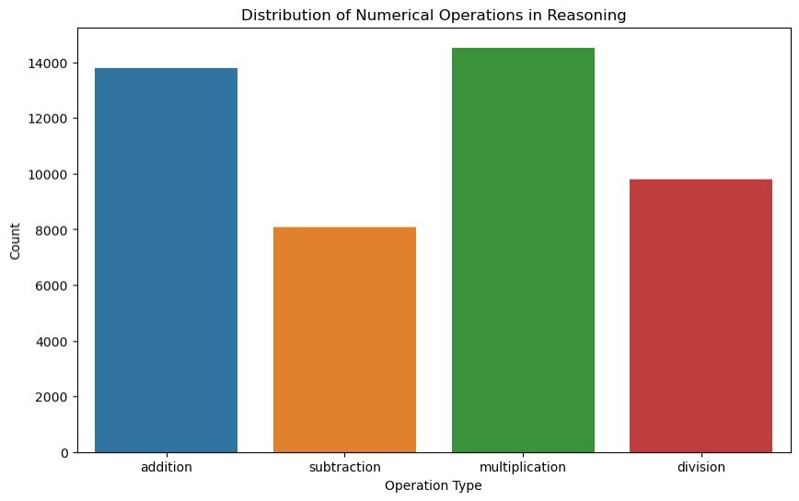
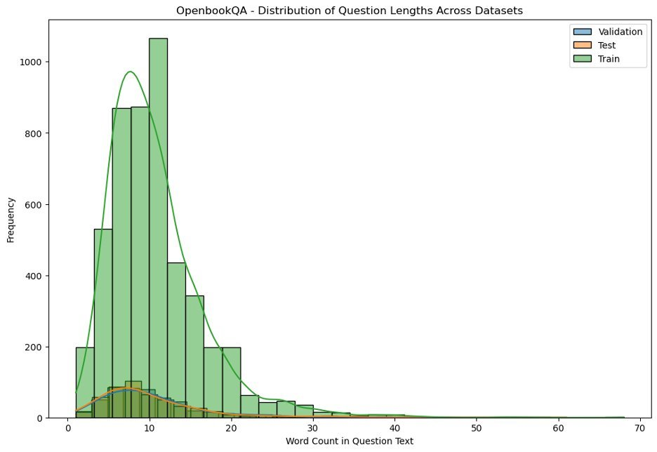
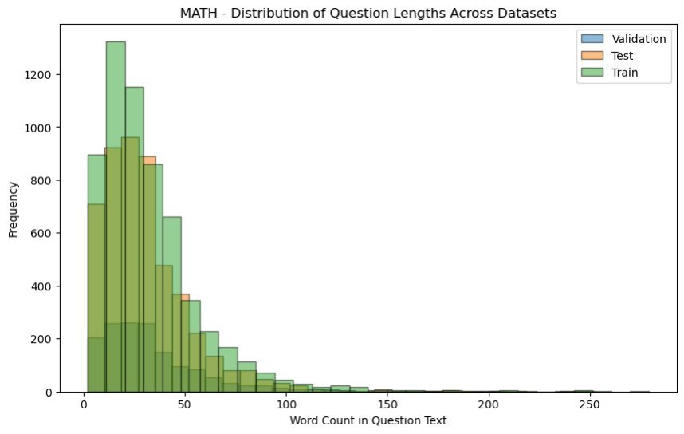
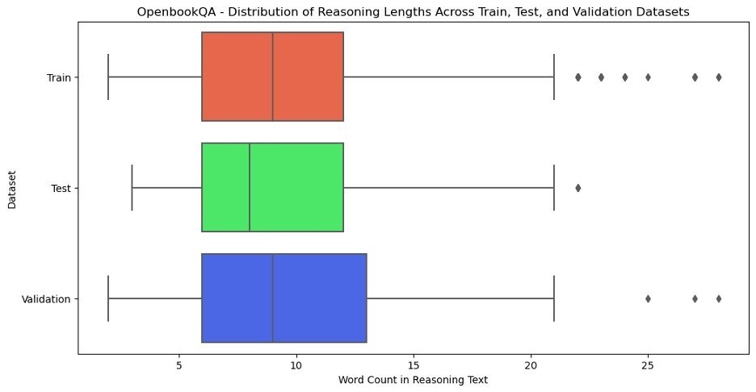
Data Statistics

Slide 12
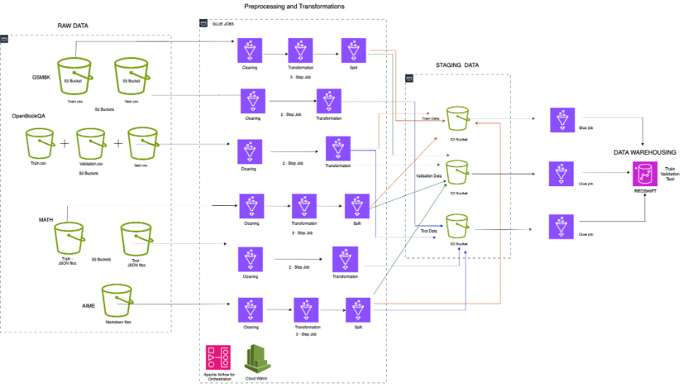
Data Management Flow

Slide 13
MODELING AND EVALUATION

Slide 14
Models and Techniques used
Models Used:
LLaMA-3.2-1B & 3B
Gemma-3-1B-IT
Deepseek R1
Phi 2
Phi 3.5 mini instruct
CoT techniques used:
Direct Preference Optimization (DPO)
Group Relative Policy Optimization (GRPO)
Chain of Draft (CoD)
Tree of Thought (ToT)
Self-Consistency (SC)

Slide 15
Model Evaluation Metrics
Metric | Description
BLEU Score | Measure surface-level similarity and overlaps between model generated and ground truth answers.
ROUGE Score | Evaluates overlap between phrases and sequences that can help to capture content similarity between original and generated responses
Correctness | ChatGPT (GPT3.5-Turbo) was used to assess if the fine-tuned model’s answer were factually correct compared to the ground truth answe
Logical Coherence | Evaluation for the logical flow from start to end is what these metric tracks, correctness is not a factor during this evaluation. The idea is to ensure that the generated response follow a proper logical flow
Step Alignment | Evaluates whether the generated responses have steps that align with ground truths or not
Completeness | Evaluates whether the responses are complete as compared to ground truth. This helps to track if the number of tokens used for responses were sufficient to provide a complete answer or if there were gaps in the answers
Reasoning Length Ratio | Evaluates the verbosity and consistency for the generated responses
Error Identification | Evaluates for arithmetic or reasoning mistakes in the generated responses when comparing with provided reference answers
G-Eval (Generalized Evaluation for Reasoning) | G-Eval is DeepEval’s foundation framework that can accurately assess the quality of LLM responses using LLM as a judge with human like precision. It is highly customizable and versatile and can be effectively employed to review the results from fine-tuned LLM models.

Slide 16
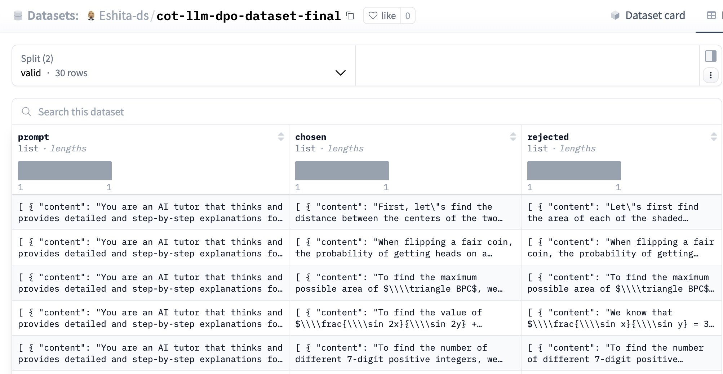
Direct Preference Optimization (DPO)
DPO is a method to fine tune a pre-trained LLM by just not helping model to learn from answers, but to learn from preference between the answers. In other words, a smart way to train AI not just what to answer, but how to answer better.
DPO helps the model learn what makes one explanation better than another, which is perfect for building clear, logical CoT responses.
Instead of just showing the model the “right” answer, we show it two answers and teach it to prefer the better one.
To achieve this, preference dataset was created where each question had multiple answers.
The responses was manually labelled as chosen and rejected based on human understanding of logical steps.
Dataset for DPO based tuning
https://huggingface.co/datasets/Eshita-ds/cot-llm-dpo-dataset-final

Slide 17
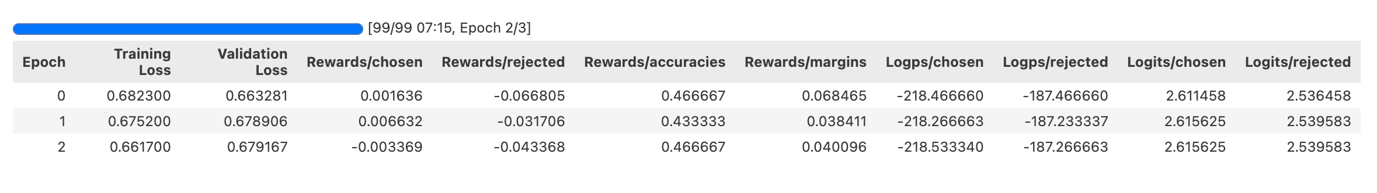
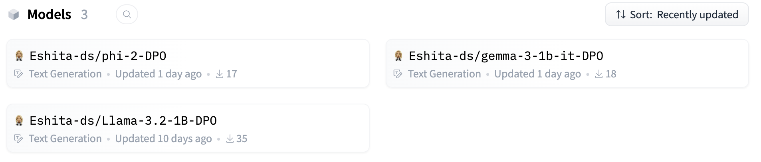
Direct Preference Optimization (DPO) - Model Execution
Dataset was curated and it was uploaded to Hugging Face Hub with the format needed for DPO
This custom dataset was then split into a training set (90%) and a validation set (10%) to ensure the model could learn effectively and be evaluated properly during training
Hugging Face library TRL (Transformer Reinforcement Learning) was used for the DPO Training. Models had to be loaded in full precision (BFloat16) as DPO does not support 4-bit or 8-bit quantization.
It was noticed during training, the training loss steadily went down from 0.68 to 0.66 (LlaMA-3.2), which meant the model was getting better at understanding the data
The validation loss stayed consistent around 0.67 (LlaMA-3.2), which showcase model was learning well without overfitting. Reward values were also reviewed which tell us how much the model prefers the better answers.
Training was executed on the models LlaMA-3.2-1B-Instruct, Gemma-3-1B-it, Phi2
Metrics for DPO training
for LLaMA-3.2-1B-Instruct
Tuned models published
to HF model hub

Slide 18
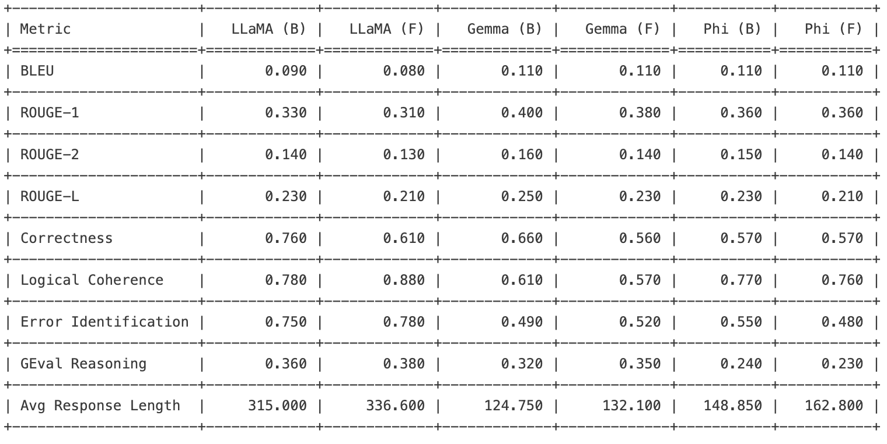
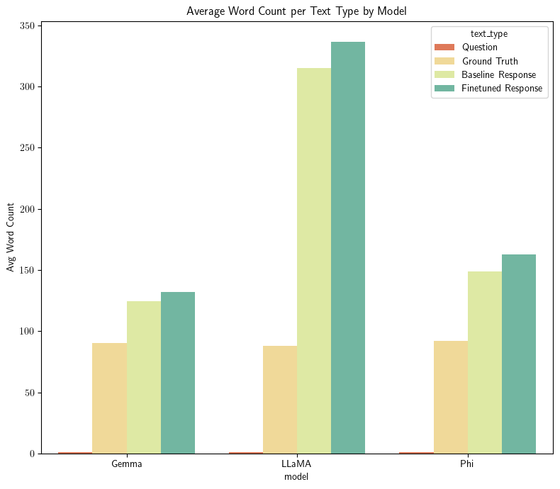
Direct Preference Optimization (DPO) - Model Comparison
The table compares the performance of three models, LLaMA, Gemma, and Phi, in their baseline (B) and finetuned (F) versions, where the finetuned models were optimized using Direct Policy Optimization (DPO). Looking at the results, we can see that finetuning with DPO has mixed effects. Even though traditional metrics like BLUE, ROGUE are not improved much, we see improved error identification and G-Eval reasoning scores for Gemma and LlaMA. Also, the response lengths have increased across the board, that shows model is trying to reason more and provide more elaborate responses.

Slide 19
Chain of Draft (CoD)
Reasoning and prompting approach following the mental activity of jotting down ideas in few, concise steps.
Model Execution
Model - LLaMa 3.2 (3.2 billion parameters).
Unsloth library used for efficient model fine-tuning.
Separate CoT and CoD prompts for analyzing the model performance and execution.
Model was loaded in a quantized 4-bit state to reduce memory usage during training.
Trained model is then stored on Huggingface model hub.

Slide 20
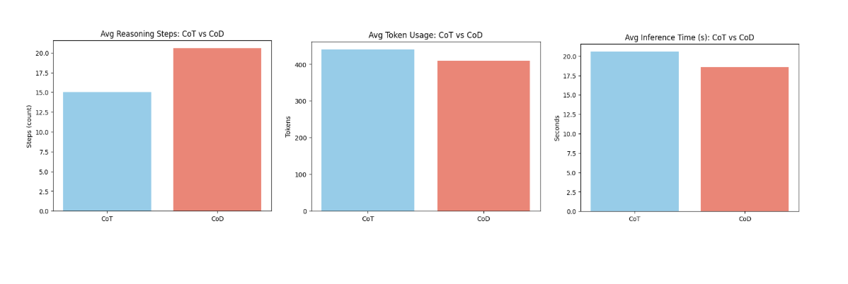
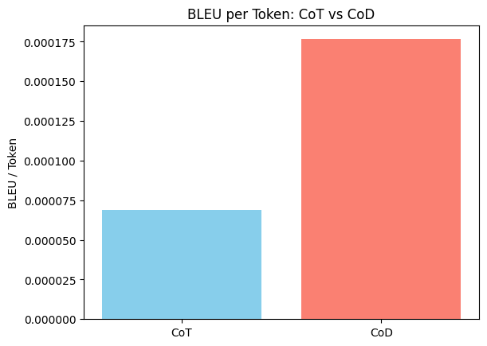
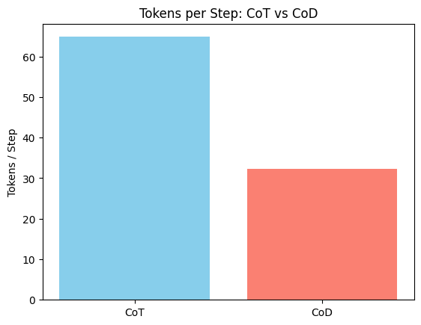
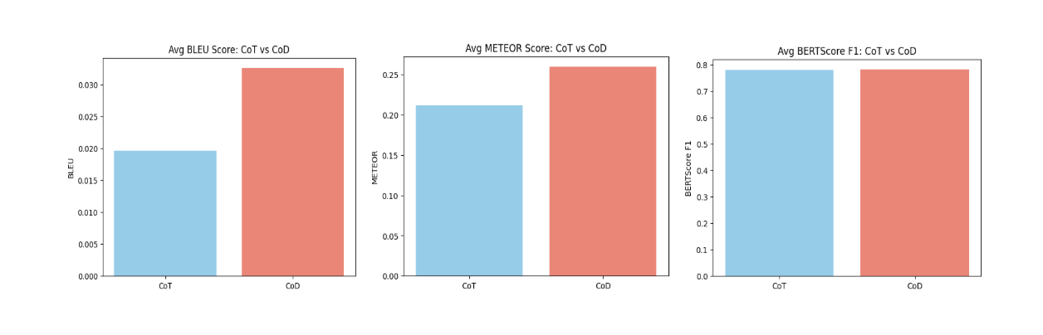
Chain of Draft (CoD) - Model Evaluation

Slide 21
Group Relative Policy Optimization (GRPO)
GRPO is an efficient Reinforcement Learning algorithm introduced by DeepSeek that were responsible for the DeepSeek-R1 models.
Unlike PPO, GRPO doesn't require a separate critic model, thus significantly reducing memory and improving efficiency.
Calculates "rewards" based on the relative performance within a group of sampled outputs from the LLM for each prompt.
Reward functions (each is scored between 0-1) -
Format Reward (conform to <think></think> and <answer></answer> tags)
Accuracy Reward (using math-verify library)
Similarity Reward (similarity to ground truth answer(s))

Slide 22
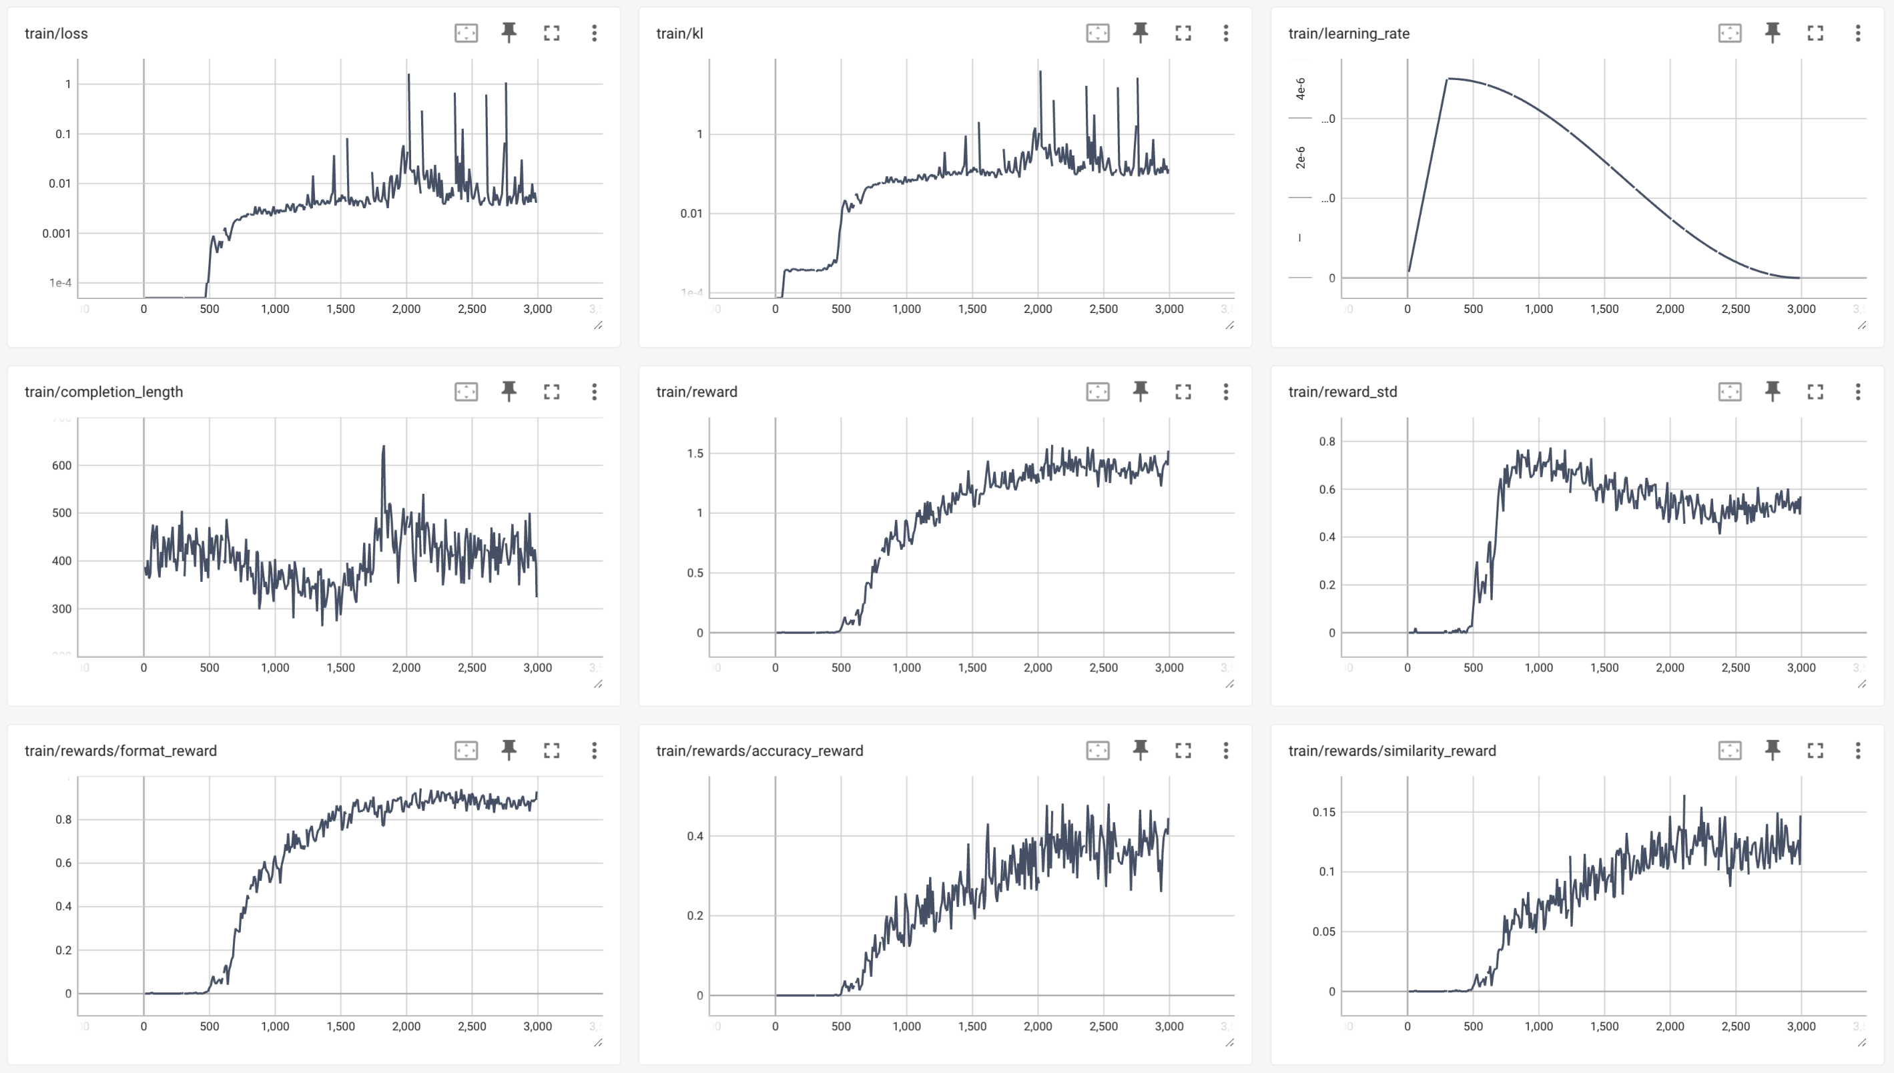
GRPO + COT
GRPO combined with Chain of Thought
LoRA (rank 16) instead of full fine-tuning
Batch Size of 4
Fine-Tuned for 3000 steps
Unsloth for efficient memory management and quick inference

Slide 23
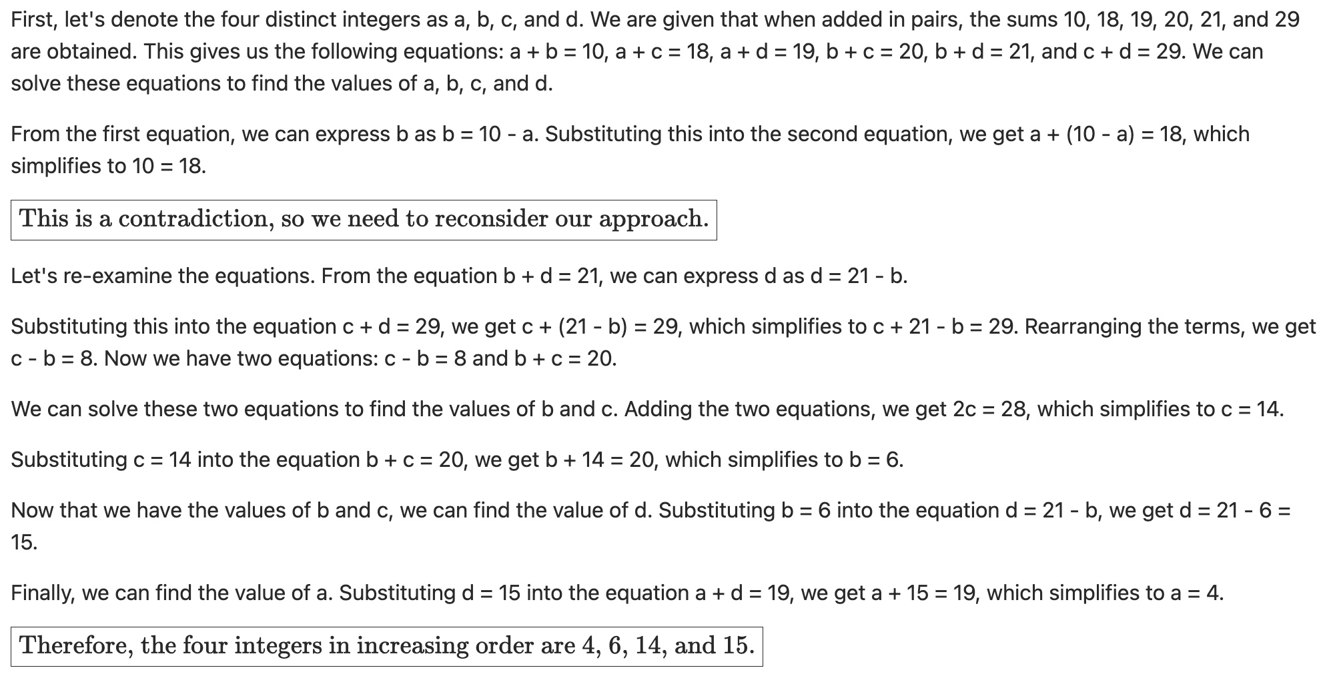
“AHA MOMENT” – GRPO + COT

Slide 24
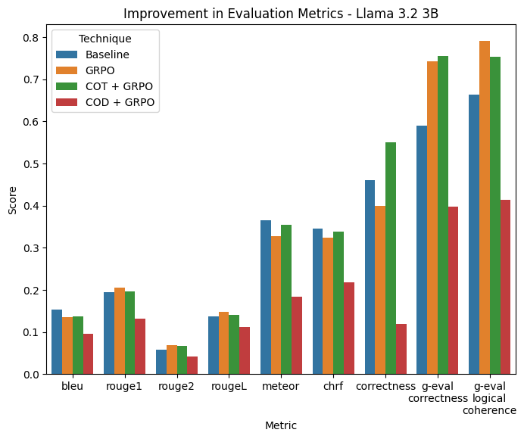
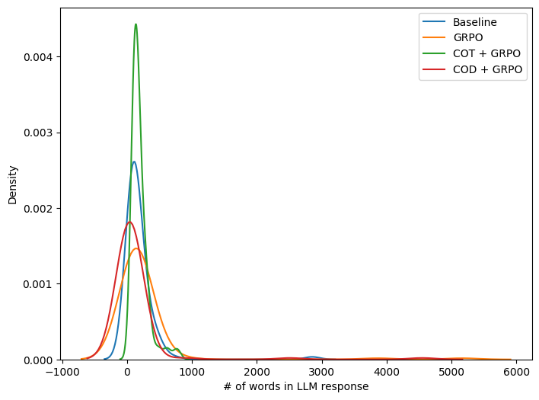
GRPO Performance Analysis
Baseline Average Length – 179 words
GRPO Average Length – 244 words
GRPO + COT Average Length – 194 words
GRPO + COD Average Length – 122 words

Slide 25
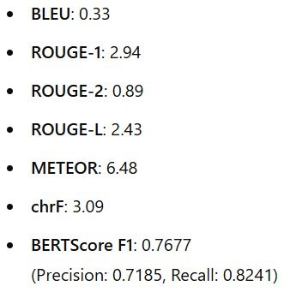
Tree of Thought (ToT)
Tree of Thought (ToT) is a multi-path reasoning framework that enhances a model’s problem-solving by exploring multiple reasoning trajectories.
Instead of committing to a single chain like in Chain-of-Thought (CoT), ToT generates multiple candidate thoughts (branches), evaluates them, and selects the best path toward a solution.
The DeepSeek-R1-Distill-LLM was fine-tuned using QLoRA on the MATH dataset.
For each problem, the model was prompted to generate multiple intermediate steps (thoughts) using <think> tags.
Each path was evaluated based on semantic completeness, logical coherence, and final correctness.
The most promising solution path was selected and expanded further, similar to tree pruning in search algorithms.

Slide 26
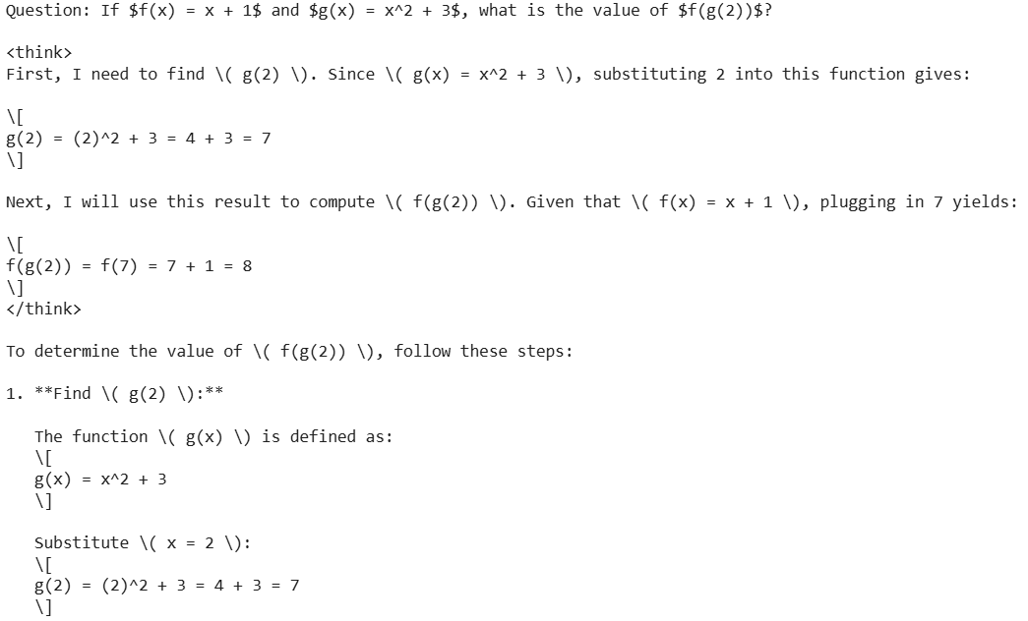
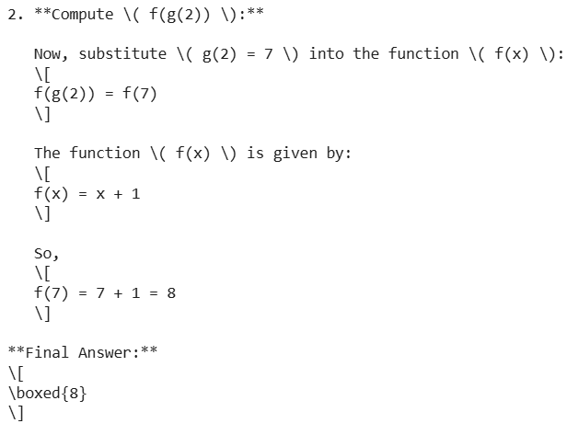
Tree of Thought (ToT)

Slide 27
Self-Consistency (SC)
Objective:
Enhance the logical coherence and reliability of model responses by generating multiple candidate answers and selecting the most consistent one.
Aim to improve reasoning quality by ensuring consistency across different responses to the same question.
Execution:
For each input question, the model generates multiple responses (n=5).
Responses are evaluated for logical consistency and coherence using metrics like BLEU, ROUGE, and BERTScore.
The most consistent response is selected as the final output.

Slide 28
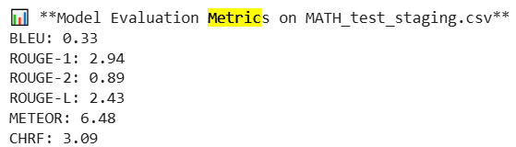
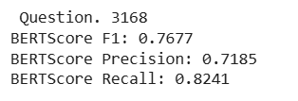
Self-Consistency (SC)
Model Evaluation
A thorough evaluation process using BLEU, ROUGE, METEOR, and BERTScore to measure surface-level and semantic similarity.
Self-Consistency (SC) approach to enhance logical consistency by selecting the most coherent and accurate response from multiple generated candidates.
Focus on improving reasoning accuracy and logical coherence through the SC technique.

Slide 29
DPO + GRPO Model Comparison
Llama 3.2 1B with just DPO outperformed the DPO+GRPO combination, this was noticed across various key metrics. Higher BLEU score (0.08402 vs. 0.06563) is an indicator of better translation quality.
With DPO a higher G-eval Logical Coherence score (0.8825 vs. 0.805) and a higher G-eval Score (0.38378 vs. 0.28518) was achieved demonstrating more coherent and logically sound outputs.
With DPO the model achieved a much higher Step Alignment score (0.81875 vs. 0.6715). This is indicative of more structured reasoning steps and making it better suited technique for our use case.
DPO also showed stronger error identification capabilities (0.78 vs. 0.665), this enables it to detect and avoid mistakes with higher accuracy.
DPO+GRPO produced longer reasoning outputs, which shows it was able to think more, however, with DPO concise reasoning provided better effectiveness as is evident with higher g-eval score.

Slide 30
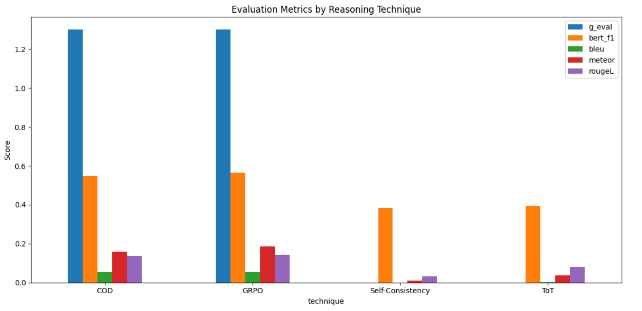
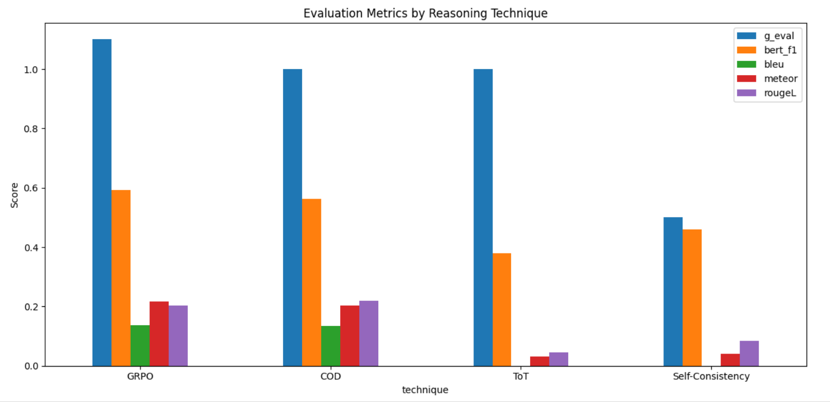
Evaluation Metrics - Gemma 1B vs 4B

Slide 31
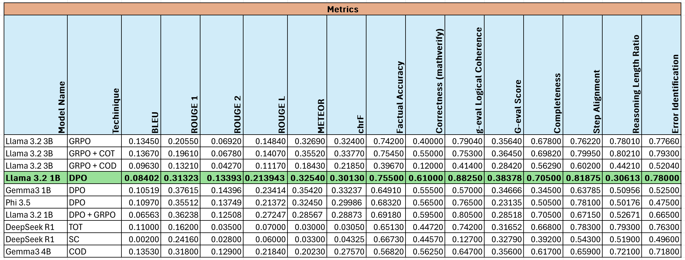
Evaluation Metrics

Slide 32
Final Model Selection
The Llama 3.2 1B-DPO model achieves the highest G-eval score of 0.38378, making it the best-performing model among the models that we tested.
Llama 3.2 1B will be the primary model used with the Airflow pipeline owing to its strong performance and small size, making it the preferred choice for continuous integration and fine-tuning.
Key insights:
DPO-based fine tuning technique shows impressive performance, particularly with the Llama 3.2 1B model.
Combining GRPO with DPO or COD generally yields lower g-eval scores
Llama 3.2 3B-GRPO+COT’s performance is almost at par with DPO on a model with lower number of parameters.
Gemma3 1B and 4B yielded almost similar results with different techniques.
DeepSeek-R1 with self consistency was the worst performing model.

Slide 33
SYSTEM DEVELOPMENT AND WEB PROTAL

Slide 34
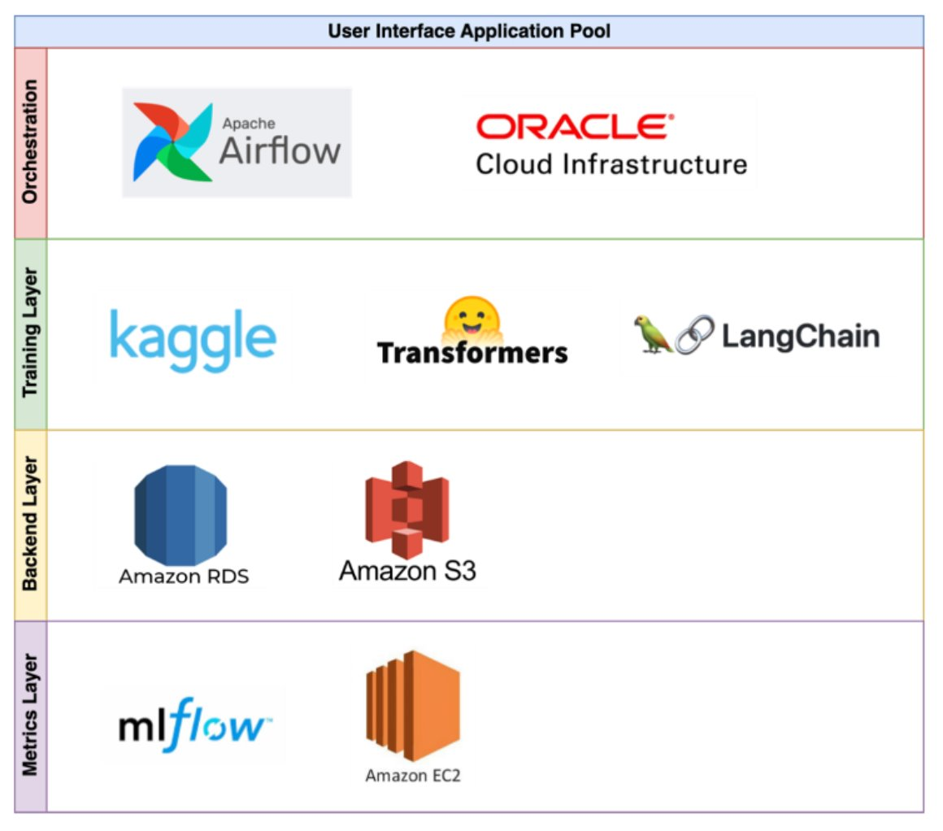
Infrastructure Overview
Application Hosting – Hugging face Spaces with ZeroGPU access.
Database Management - AWS RDS to host the MySQL database
Orchestration - Apache Airflow hosted on Oracle Cloud compute instance - to orchestrate the model re-training and fine-tuning pipeline
Model Management - Fine-tuned models will be stored and versioned on the Hugging Face Model Hub
MLFlow - hosted on AWS EC2 will be used for model registry, experiment tracking and comparison.
Fine-Tuning – Kaggle and Google Colab will be used for GPU access.

Slide 35
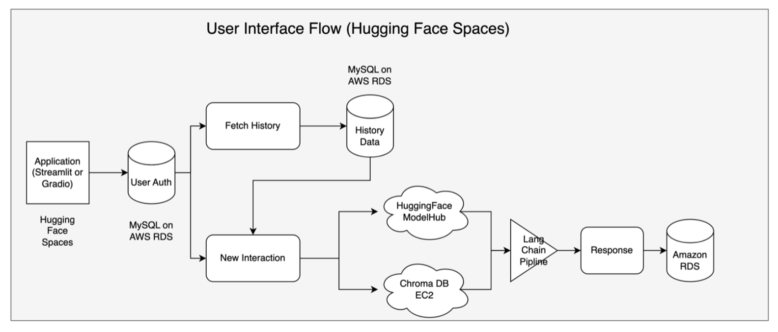
System Architecture & Infrastructure
Gradio based Chatbot Application hosted on Hugging Face spaces with ZeroGPU access for inference.
Users - Login, Interact and Save chat history
Access control through user authentication with Amazon RDS
Review the history of past conversations stored in DB
Fetch registered model from Hugging Face model hub and relevant context from RAG DB
Final Prompt will be fed to a pre-trained and fine-tuned LLM using Hugging Face Transformers pipeline
Responses will be presented on the user interface and stored in DB for further fine tuning.
https://huggingface.co/spaces/Eshita-ds/cot-llm-298

Slide 36
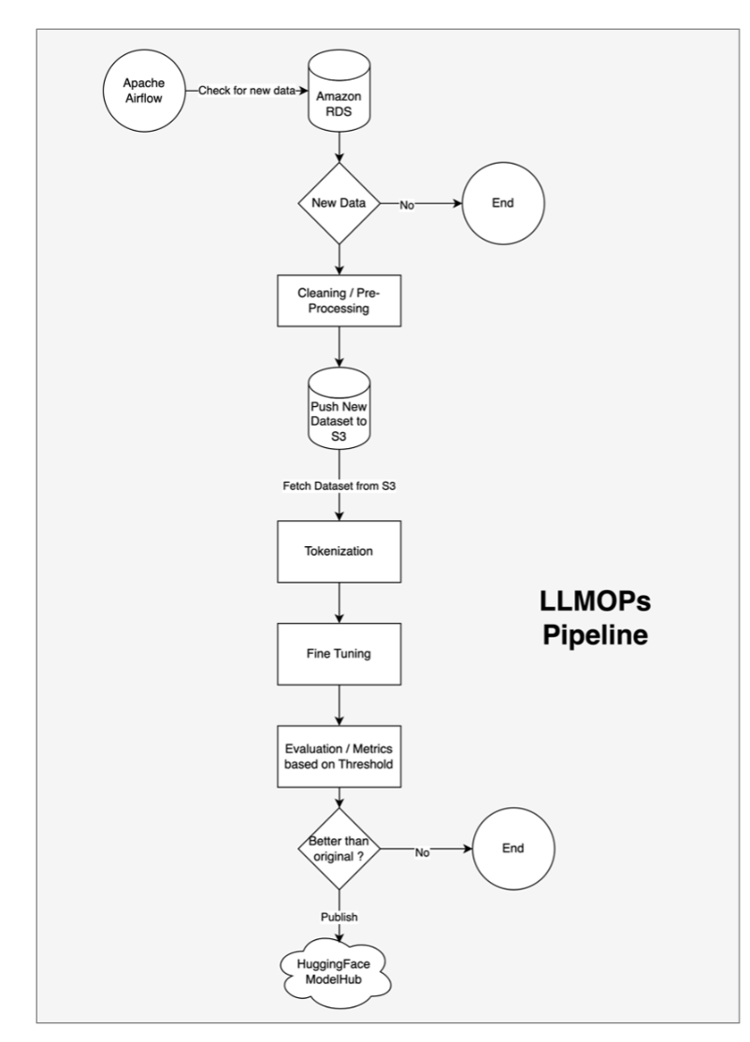
LLMOps Pipeline
Retraining baseline LLM models with new dataset generated using user interaction history.
Similar cleaning steps and pre-processing steps will be performed
Cleaned data will be pushed to S3 bucket
Data will be retrieved from S3, tokenized and fed to training pipeline
Model metrics logged into monitoring platform (MLFlow) to compare with the baseline model.
If improvement is seen, baseline model will be updated with new versioned model on hugging face model hub
The entire pipeline will be executed on pre-defined schedules for continuous re-training.

Slide 37
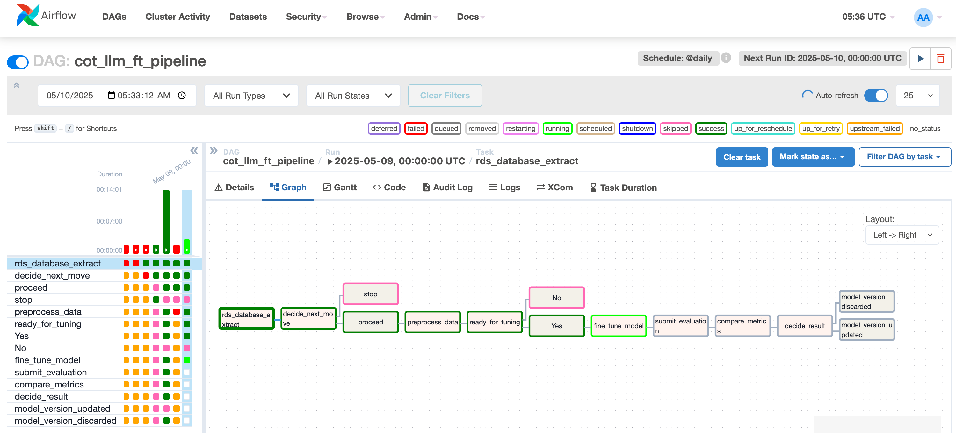
Airflow DAG

Slide 38
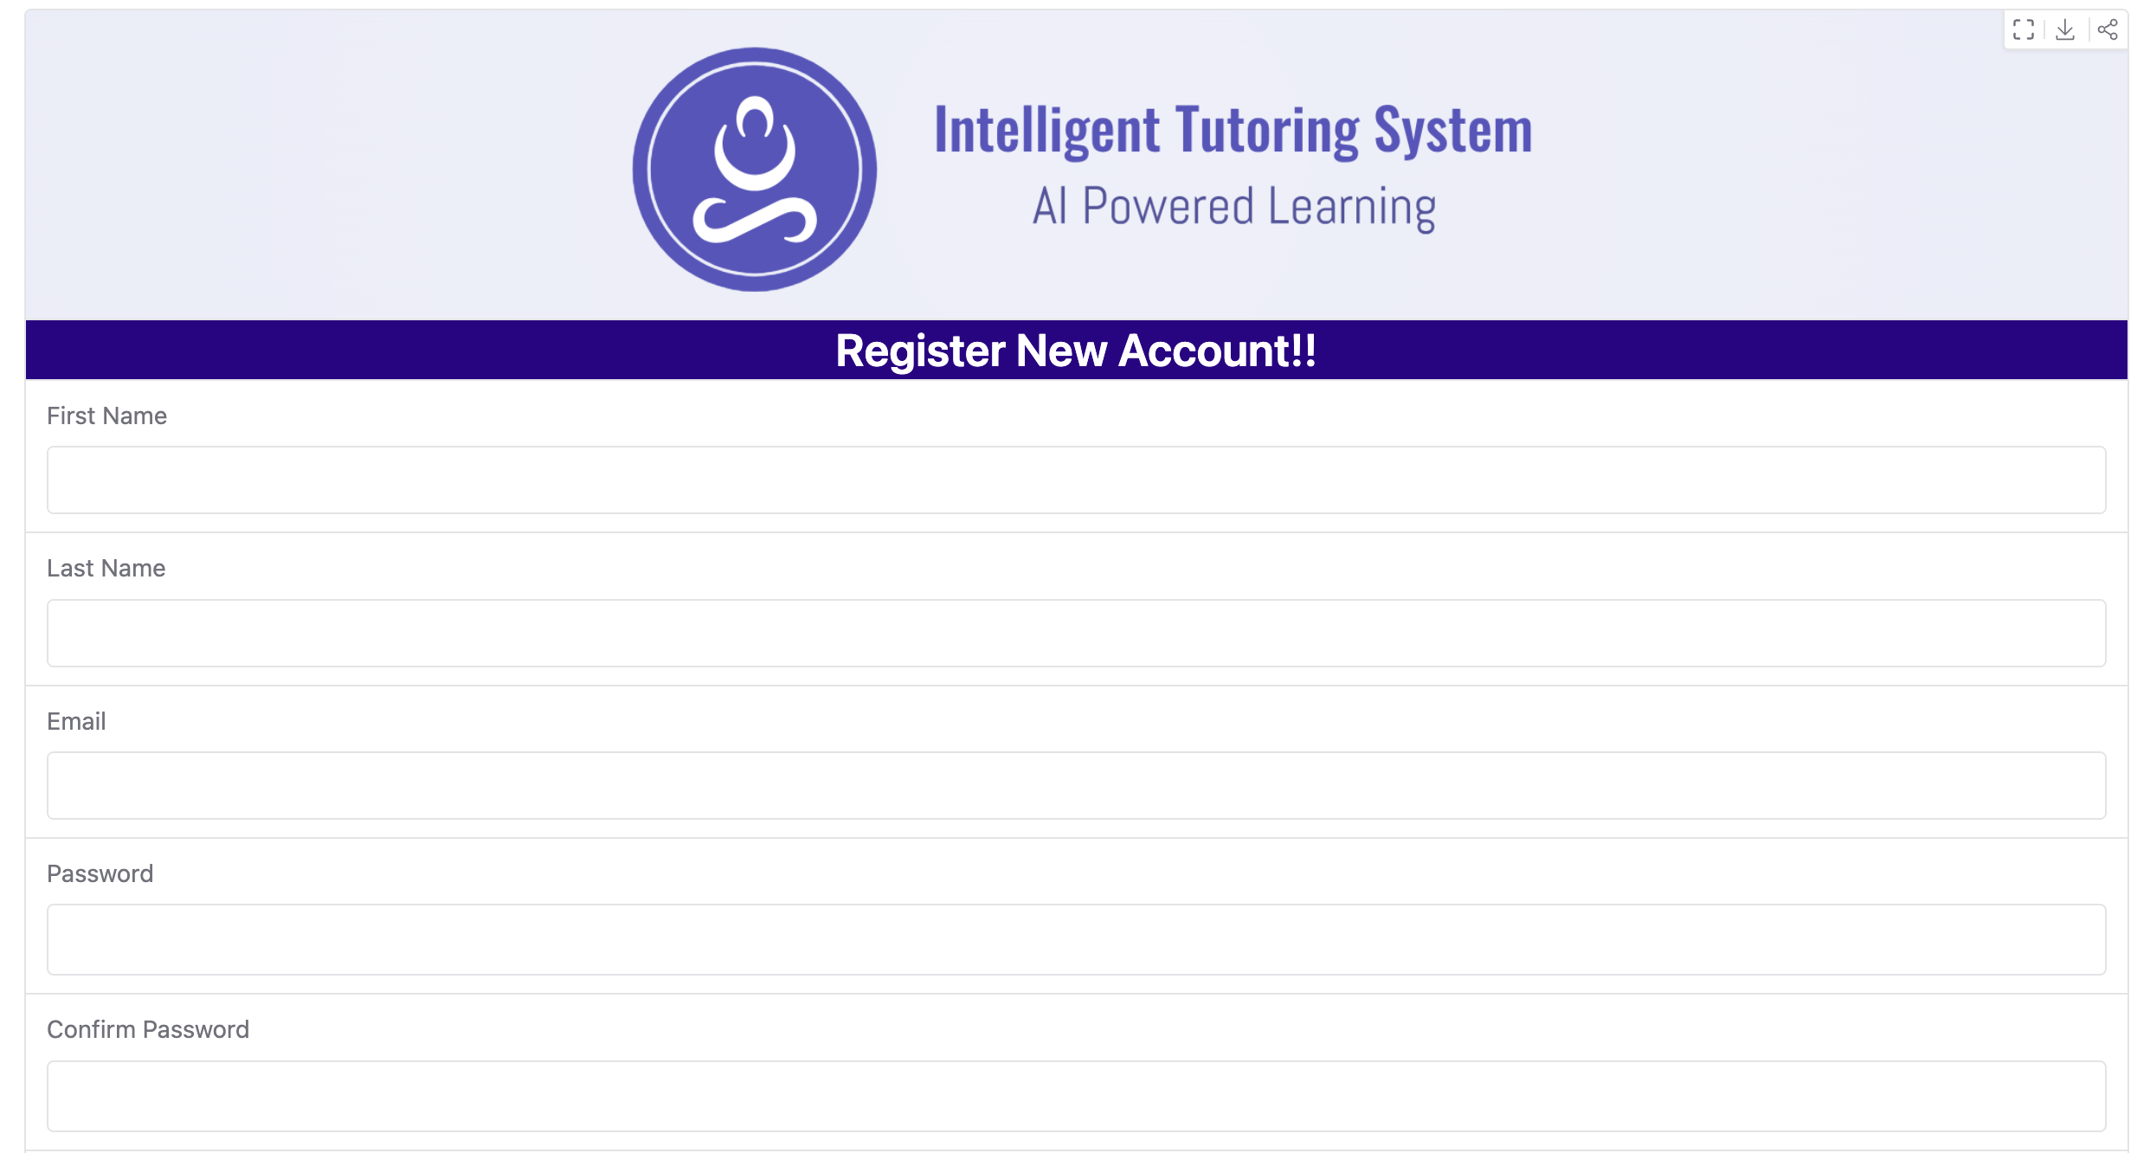
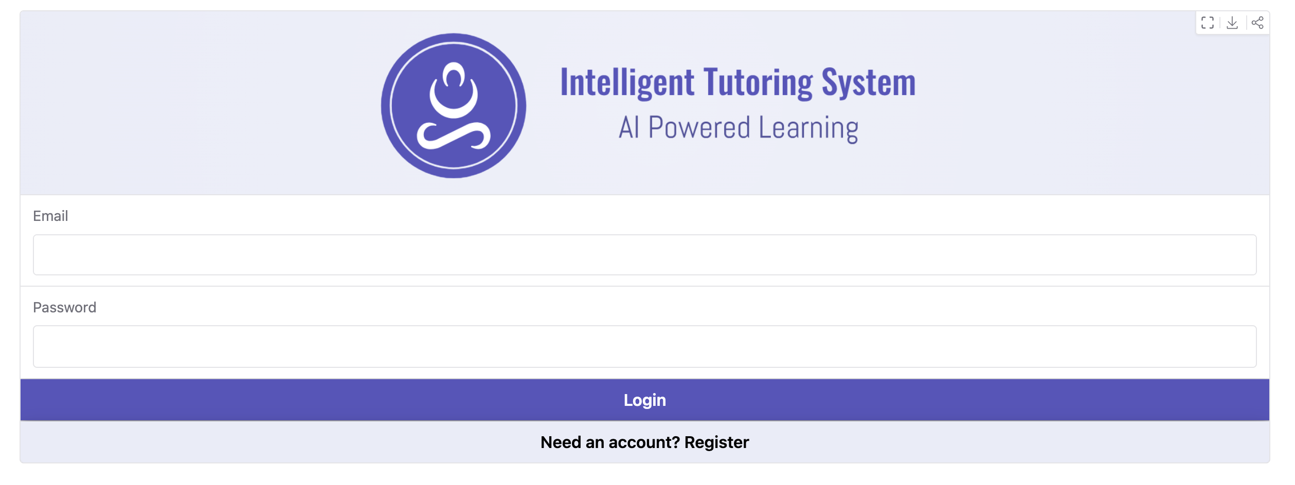
Web UI – Login / Registration Page
https://huggingface.co/spaces/Eshita-ds/cot-llm-298

Slide 39
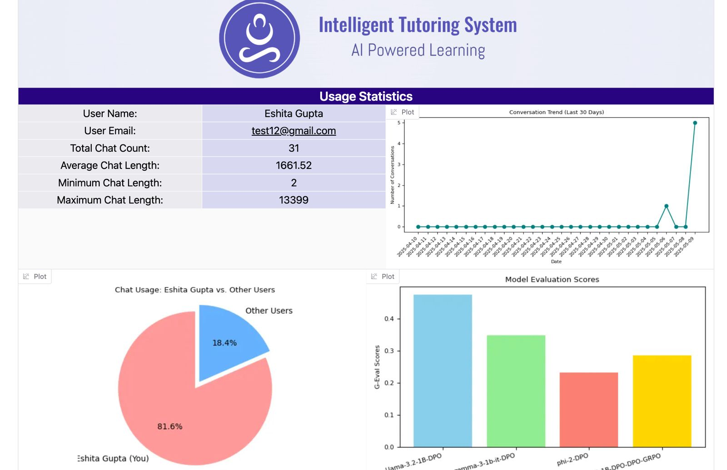
Web UI – Landing Page

Slide 40
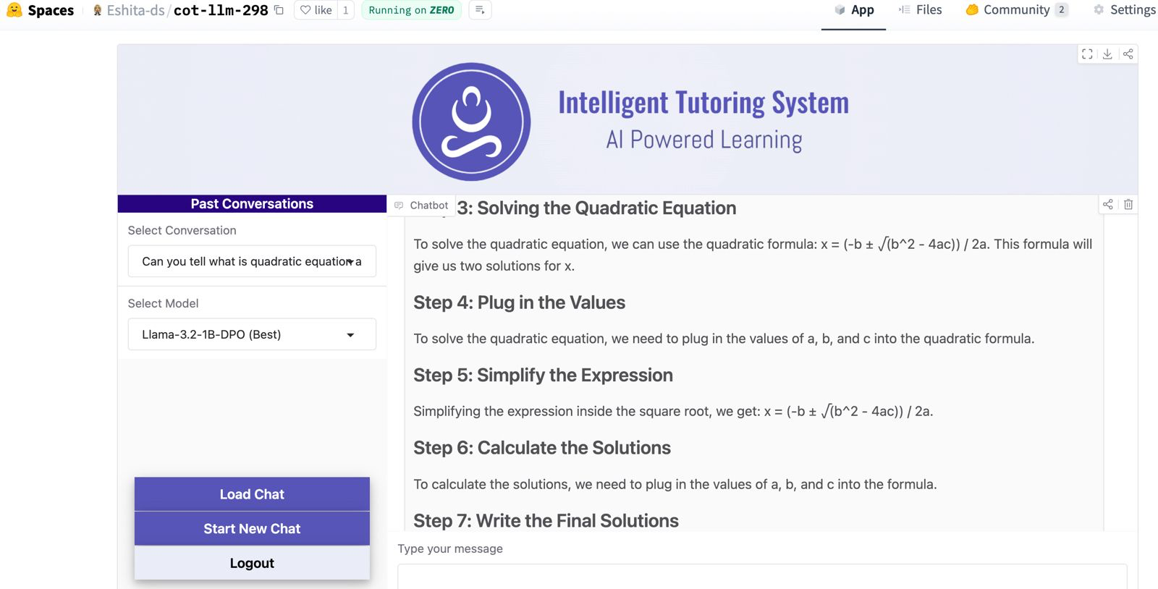
Web UI

Slide 41

Thank you

